Slide 1
Policy considerations for effective EV-based evacuations
Improving Preparedness of Communities for Evacuations using ZEVs
3rd Stakeholder Workshop
October 2, 2025

Slide 2
Motivation and Aims
Inform our modeling and analysis activities
Assess and compare policy and planning strategies
Identify preferences and feasibility of different policies/planning
Provide guidance and recommendations for policies and practices that support positive ZEV evacuation outcomes

Slide 3
Policy and planning options span multiple sectors and scales
Charging Infrastructure
Vehicles
Transportation Infrastructure
Energy Infrastructure
Notes:
X% of battery charge in reserve that can be “unlocked” during emergency declaration (example of Tesla’s during Hurricane Irma)

Slide 4
Overview of strategies for consideration
Strategy # | Strategy | Description
1 | Backup energy – fossil fuels | Require public charging stations to have on-site backup energy to maintain operability during power outages. The backup power would come from diesel generators (or similar)
2 | Backup energy - microgrid | Require public charging stations to have on-site backup energy to maintain operability during power outages. The backup power would come from microgrids consisting of some combination of solar/wind energy and battery energy storage
3 | Free/open charging | During emergency declarations, public charging stations would be “unlocked” so that people can essentially drive up and immediately start charging without having to pay or interface with any kind of app or point of service system. Charging companies could be reimbursed by federal/state governments
4 | Mobile chargers at origin | Dispatch mobile chargers (of any type) to evacuation zones prior to the event to increase the initial state of charge and reduce the need for charging along the evacuation route
5 | Mobile chargers to supplement existing charging locations | Dispatch mobile charges (of any type) to sites with existing stationery charging infrastructure. The mobile chargers would act as supplemental resources to the existing charging infrastructure

Slide 5
Overview of strategies for consideration (continued)
Strategy # | Strategy | Description
6 | Mobile chargers at designated locations along evacuation route | Dispatch mobile chargers (of any type) to designated locations (e.g., rest stops, shopping centers, etc.) along evacuation routes that have minimal existing charging infrastructure
7 | Minimum “charge reserve” required on all EVs | On all EVs, require a certain % of battery charge to be kept in reserve that can be unlocked during an emergency declaration
8 | Bussing/shuttling people out of evacuation zones | Use buses or shuttles (or any type) to facilitate the evacuation of people rather than relying on personal vehicles. This could reduce congestion on the road, as well as demand at downstream charging stations
9 | Staggered departures from evacuation zones | Specify time periods when different locations can evacuate. This could reduce congestion on the road, as well as demand at downstream charging stations
10 | Minimum “spinning reserves” required in the power grid | Require utility companies and electricity grid operators to keep a certain amount of electricity generation capacity on “standby”. This can support a rapid uptick in charging demand prior to and during an evacuation. It also provides some “backup” capacity in reduced generation from solar/wind

Slide 6
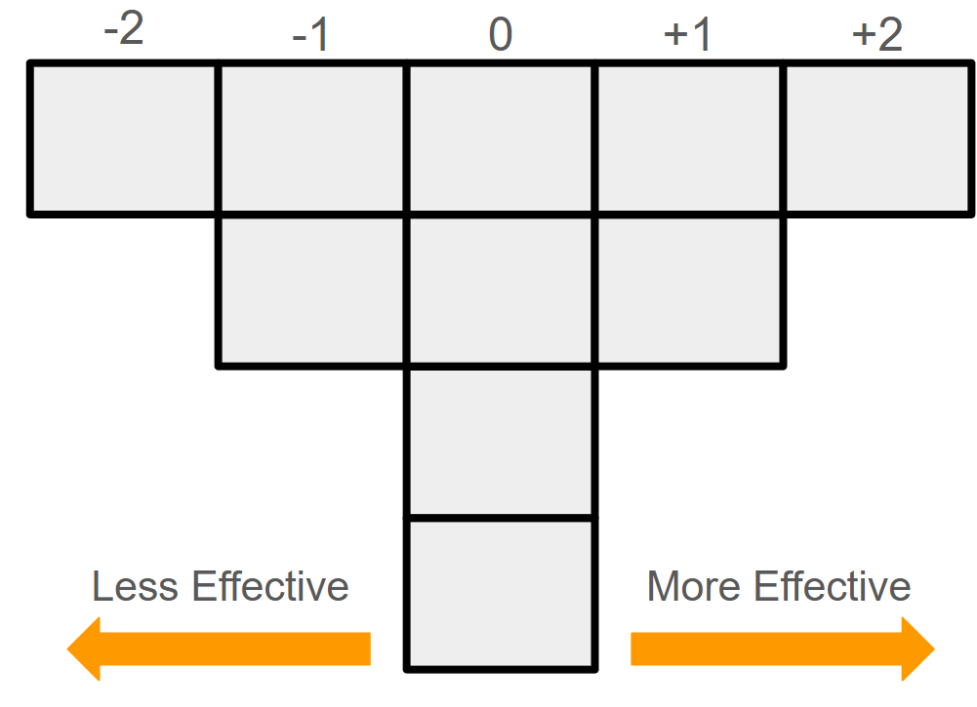
Q Sort Methodology
Notes:
Q-methodology incorporates both qualitative and quantitative research methods, and it allows researchers to explore shared and/or discrete views among participants and discover significant viewpoints and the range of variability among different strategies/options

Slide 7
How do the strategies rank?
More Effective
Tier 1
Mobile chargers along evacuation route
Tier 2
Free/open charging
Mobile chargers to supplement existing charging
Tier 3
Mobile chargers at origin
Tier 4
Backup Energy – Fossil Fuels
Minimum “charge reserve” on EVs
Tier 5
Backup Energy – Microgrid
Minimum “spinning reserves” in power grid
Tier 6
Staggered departures from evacuation zones
Bussing/ shuttling out of evacuation zones
Less Effective
Notes:
Strategy that was most cited as the most effective:
Mobile chargers along evacuation route
Free/open charging
Strategies most cited as least effective:
Backup energy – microgrid
Bussing/shuttling people

Slide 8
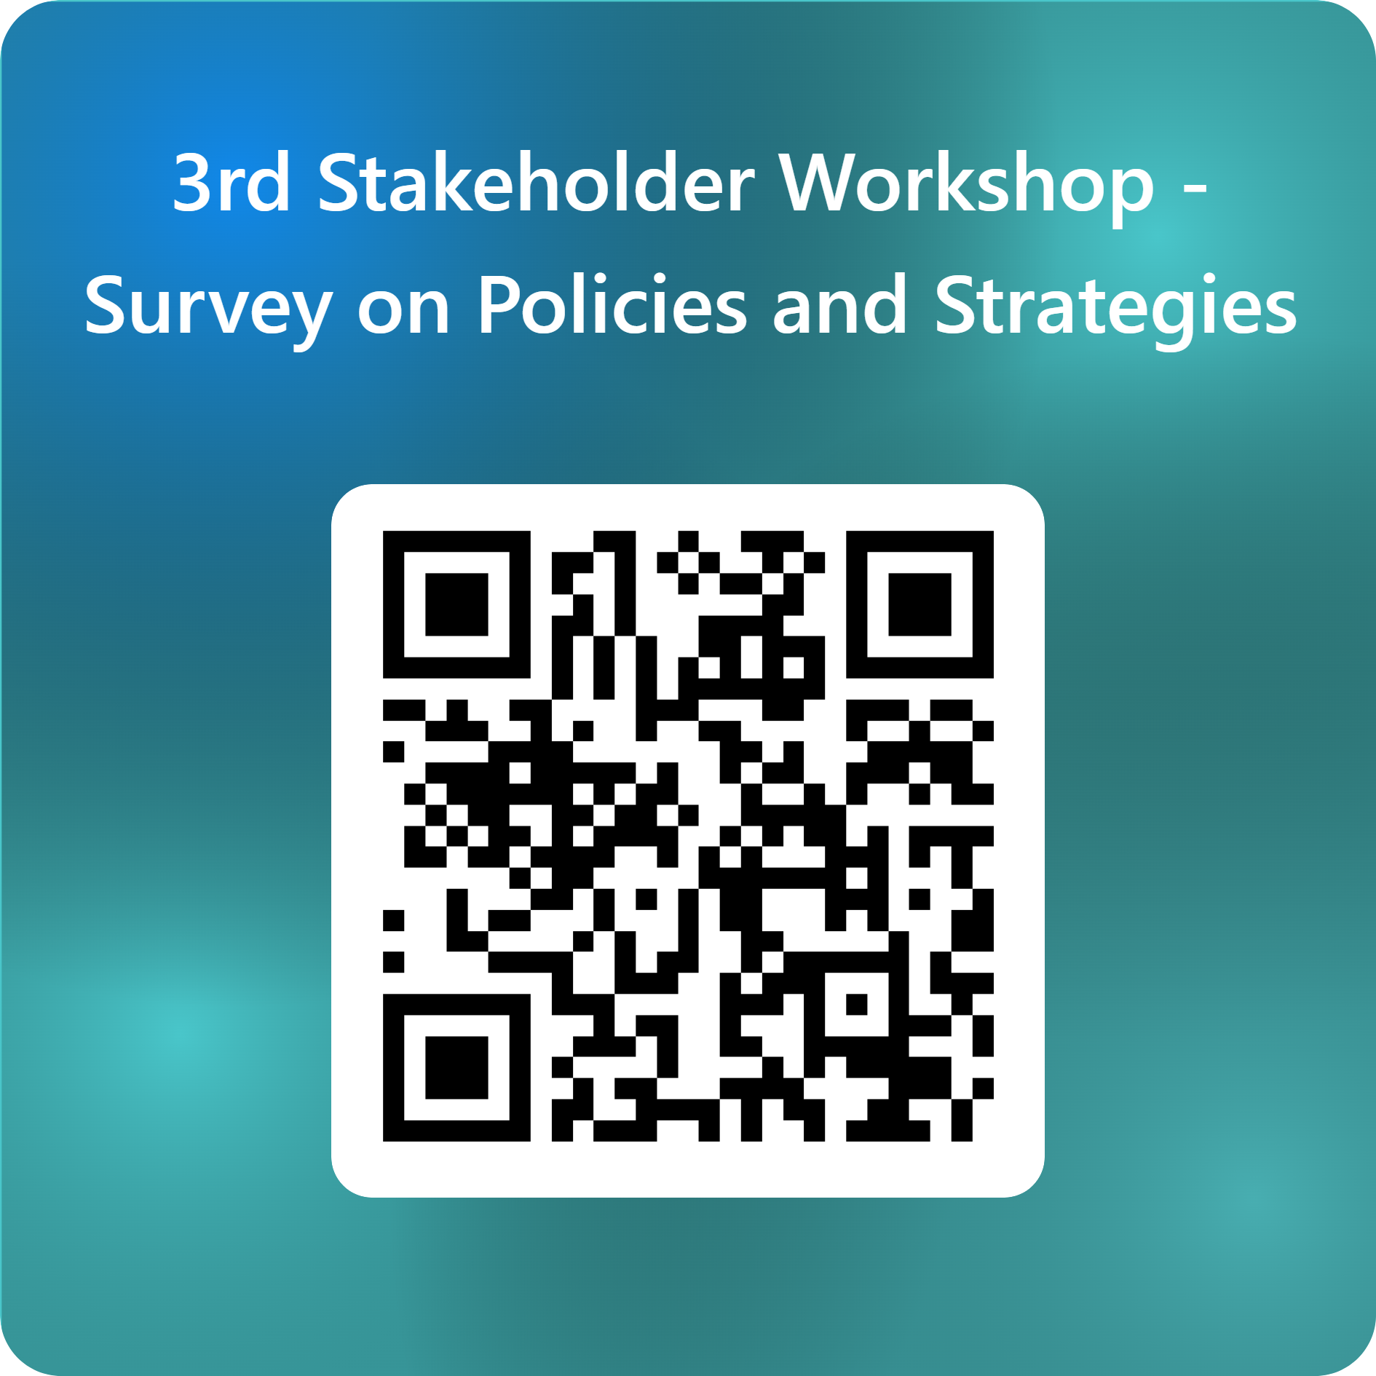
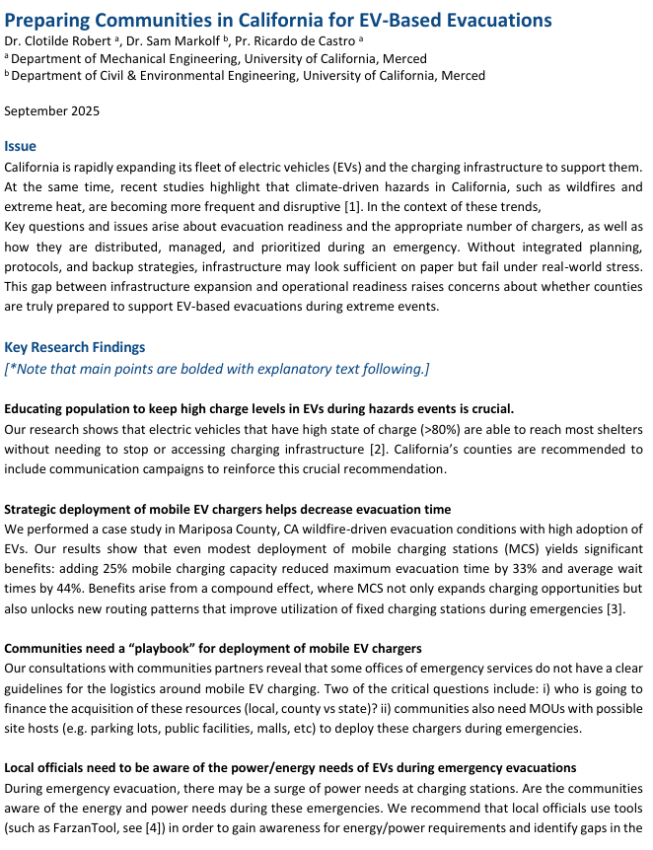
We’d love to have your input and perspective…
Policy Brief summarizing our key findings and recommendations
https://forms.office.com/r/ZxhgvxwQiC
There is link to document in our Agenda

Slide 9
Thank you!!!
Please don’t hesitate to reach out if you have questions, comments, suggestions, or ideas
Sam Markolf,
Assistant Professor
Civil and Environmental Engineering
UC Merced
smarkolf@ucmerced.edu

